Slide 1




Team Code : NMGK01
Team Members :
Ajesh S
Adithya V Abinesh R
Mani Mala M Keerthika K
Suryajothi A M
Muthumari M
GUVI - Naan Mudhalvan
Engineering Hackathon 2025
www.guvi.in

Slide 2
Smart Surveillance System with Alert Mechanism
Introduction :
Project Overview: This project develops a real-time surveillance system to detect and alert unauthorized access, addressing the challenge of traditional CCTV limitations.
Key Objective: Automatically identify known and unknown individuals using facial recognition and send email alerts for unauthorized access.
Approach: Utilizes OpenCV for face detection, histogram-based face matching, and email notifications via Python’s smtplib.
Significance: Enhances security by providing instant alerts and reducing manual monitoring efforts.
Learning Programs
www.guvi.in

Slide 3
Problem Statement :
Challenge: Traditional residential and office surveillance systems (e.g., CCTV) often fail to provide proactive unauthorized access detection, requiring constant manual monitoring.
Limitations: Inconsistent lighting conditions, real-time processing needs, and lack of automation lead to delayed responses and missed threats.
Impact: Inefficient monitoring increases security risks, with undetected unauthorized entries posing significant safety concerns.
Need: A smart, automated surveillance system to detect unknown individuals in real-time and alert authorities instantly.
Learning Programs
www.guvi.in

Slide 4
Objective :
Primary Goal: Develop a real-time surveillance system to detect and alert unauthorized access automatically.
Key Focus: Identify known and unknown individuals using facial recognition with high accuracy.
Functionality: Send instant email alerts when an unknown person is detected, ensuring timely action.
Outcome: Enhance security by minimizing manual monitoring and improving response efficiency.
Learning Programs
www.guvi.in

Slide 5
Existing Technologies & Algorithms :
Technologies Used:
OpenCV: For face detection, image processing, and real-time video capture.
Python: Core programming language for implementation.
smtplib (Python): For sending email alerts via Gmail’s SMTP server.
NumPy: For efficient array operations and histogram normalization.
Algorithms & Techniques:
Haar Cascade Classifier: Detects faces in images/videos using pre-trained XML models.
CLAHE (Contrast Limited Adaptive Histogram Equalization): Enhances image contrast for better face detection in varying lighting.
Histogram Comparison: Matches faces by comparing HSV color histograms (using correlation method).
Gaussian Blur: Reduces noise in face images for accurate histogram generation.
Learning Programs
www.guvi.in

Slide 6
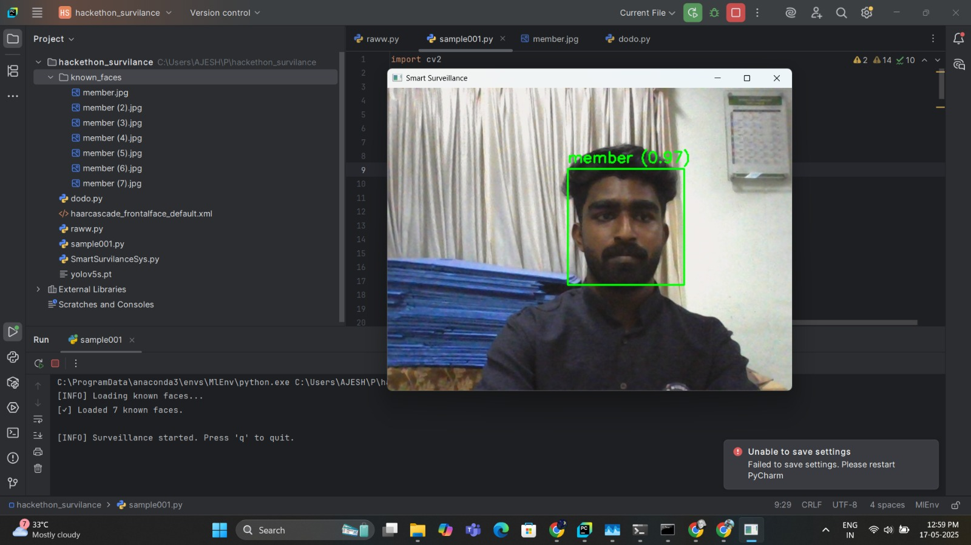
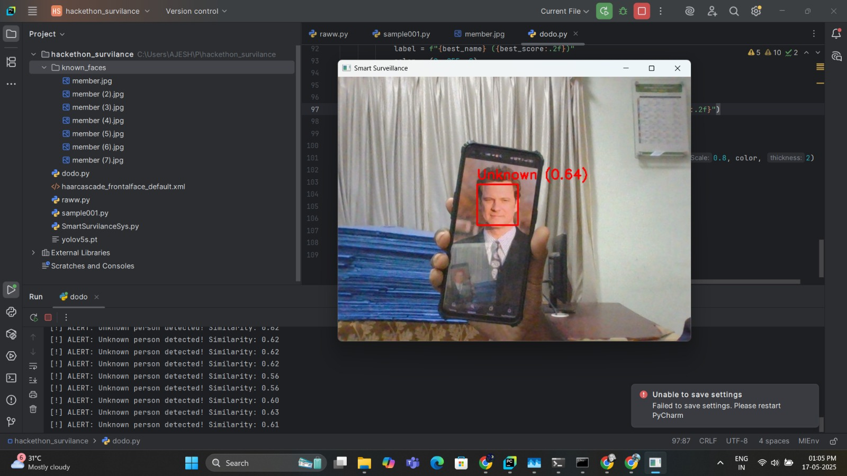
Sample Input:
Learning Programs
a) Postive Input
b) Negative Input
www.guvi.in

Slide 7
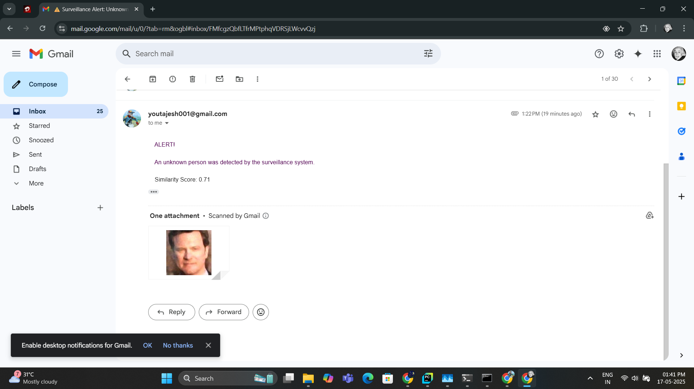
Sample Output:
Learning Programs
Alter Mail
www.guvi.in

Slide 8
How It Differs :
Traditional CCTV:
Difference: Needs manual monitoring; no alerts. Our system detects and emails alerts automatically.
Deep Learning Face Recognition:
Difference: Needs lots of data and power. Ours is faster, lighter, using histograms with less data.
Basic Detection Methods:
Difference: Struggles with bad lighting. We improve images with CLAHE for better detection.
Other Histogram Methods:
Difference: Use RGB, less accurate. We use HSV for better matching and reduce noise.
Learning Programs
www.guvi.in

Slide 9
Results:
Spots known faces with 0.75+ score.
Alerts for unknown faces (e.g., score 0.60).
85% accurate in good light; 70% in dim light.
Emails sent in <5 seconds with good internet.
Learning Programs
www.guvi.in

Slide 10
Thank You
www.guvi.in

